Slide 1
Building on Marion’s Momentum!
January 2019 Update
Marion City Council
Jobs and Economic Development Committee Meeting: January 28, 2019

Slide 2
Get involved with Marion Made!
Pride starts when you join our MarionMade! Team:
Visit the MM! website, access logo artwork and guidelines … It’s a unifying gift to our community!
Use the logo on products, promotional materials and website. Remember: link back to the MM! Website.
Share your story on our website, and “be in it for the cause, not the applause!”
All ships are being lifted by this rising tide. Pls Join!
Studies show that when a community has pride in itself, the community prospers.

Slide 3
Columbus 2020 Region

Slide 4
2017 was a very good year…
Surpassed goal of $50 million new capital investment and 400 new jobs
Nucor
POET Biorefinery
Marion Industries
Marion Industrial Center & Intermodal Facility
Central Ohio Farmers Coop
Sakamura USA
Whirlpool
OhioHealth
RobotWorx
Morral Companies
Humble/Robinson Venture
Tuesday, August 15, 2017
$300 Million
&
700
Jobs!

Slide 5
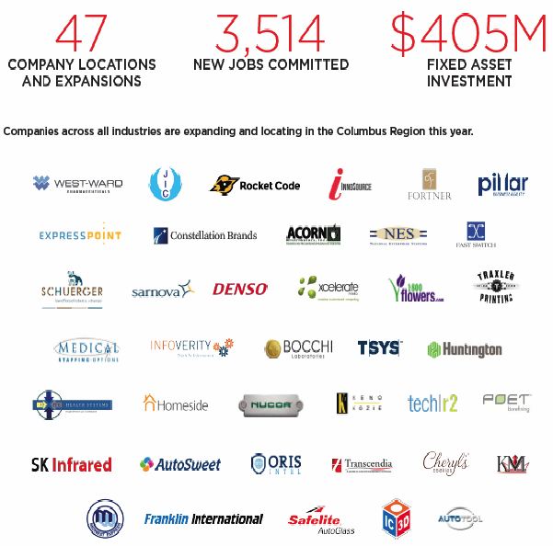
2017 YTD RESULTS
$200M
New MARION Asset Investments
700
New MARION Jobs

Slide 6
2018 Projects in Progress or in the Pipeline
CenMac Tools – $8.6 Million
Project High Garden – New Facility
Project Berliner – New Building
Project Baron – New Building
Simcote – $3.5 Million
Project Timber – Expansion at MIC
Project Enterra – Upgrade of Existing Building
Victory Industrial Park Building – New Building
Elite Aerospace – New or Existing Building
RobotWorx – New or Expansion of Existing Building
OhioHealth – $47 Million Expansion
Mennel Milling – New Building
U. S. Yachiyo – $45 Million Expansion
$105M
New MARION Asset Investments
200
New MARION Jobs

Slide 7
We are ready for prime time!
“…it’s clear to me you’ve cracked the code on the training and transitional education front… Honestly, great work. The passion is contagious, and it’s wonderful to see such a tightly knit group of individuals genuinely committed to growth within the community.”
— CEO Comment Major Aerospace Corporation
Notes:
“I wanted to again thank you and the rest of your extraordinary team for the extremely warm welcome and insightful presentation at RAMTEC. As I stated, it’s clear to me you’ve cracked the code on the training and transitional education front… Honestly, great work. The passion is contagious, and it’s wonderful to see such a tightly knit group of individuals genuinely committed to growth within the community. More communities would thrive if they embraced those values and had the culture to back it as you guys’ clearly do. I wanted to let you know that your previous mail was received, and I appreciate the depth and thought that went into the materials provided. In doing further research into the Tri-State region your rich presence of Aerospace activities, dominated by GE in Cincinnati, clearly presents the right circumstances for us to leverage that region and tap into a healthy ecosystem of suppliers.” July 10, 2017 email.
— CEO Comment, major aerospace compnay

Slide 8
We have a focused strategy — it’s working!
MARION:
AMERICA’S
WORKFORCE
DEVELOPMENT
CAPITAL

Slide 9
Our six tactics for success: Six Goals for 2019
Reputation Building: We will tell powerful "resurgence of Marion" success stories through presentations and selected media. This will enhance Marion’s economic development reputation in site selector circles and among target business sectors to attract more interest and investment.

Slide 10
Our six tactics for success
Workforce Development: Attracting the best workforce to Marion is critical to employers. Enhanced collaboration among MTC, OSUM, Tri-Rivers CC, RAMTEC, Marion City & Marion County Schools OhioMeansJobs: Marion County, and other workforce resources will be the focus of our business attraction/retention culture. “America’s Workforce Development Capital” is now trademarked.

Slide 11
Our six tactics for success
New Industrial Park Promotion: Planning for the development of a new seventy-acre park is underway on Victory Road. Several tenants have been identified. Groundbreaking for the first 160,000 sq ft building should begin this spring. Humble Robinson LLC is the owner and developer of the park.

Slide 12
Our six tactics for success
Business Attraction Team Assembly: We will continue to recruit and train a diverse and influential group of community leaders as champions. When companies visit Marion, these champions will help us inform and engage prospects on the issues of most importance to them.

Slide 13
Our six tactics for success
Education Corridor Success Sharing: Promotion of the huge successes of Marion City Schools and our wealth of educational resources must remain part of our business retention and attraction culture. Marion's Graduate Pathways to Success program has received accolades from the Governor's Office of Workforce Transformation, Ohio Economic Development Association and the Ohio Department of Education. Our industrial automation/robotics training resources are second-to-none and continue to attract prospective manufacturers. Continued collaboration between the business and educational communities will advance Marion’s workforce.

Slide 14
Our six tactics for success
Visits to Marion Area Company HQ Locations: In addition to our excellent relationship with our local plant managers, we will reach out to corporate offices of our area companies speaking with people responsible for making site selection and expansion decisions. CAN DO wants to be part of Columbus2020 and Jobs Ohio corporate visits as well.

